Slide 1
Automobile Engine Test Prediction
By
Pavan Kumar

Slide 2
Table of Contents:
Problem Statement
Data Description
Exploratory Analysis
Data Preprocessing
Model Building
Predictions
Conclusion

Slide 3
Problem Statement
Predict the new design of automobile engine will pass the test or not.
Each bench test is an expensive, noisy and time consuming process.
Instead the manufacturer would like to use some previous data on various configurations tested and determine through analytics model if their new design will pass or not.
Error Metric: Accuracy

Slide 4
Data Description
No of Records: 3156
No of Features: 22
Variable Description:
Variable Name | Description | No of Levels
ID | Unique ID's for each engine
y | Target Variable | Pass & Fail
Number of Cylinders | How many cylinders are place in an engine | 3 Levels(4,6,8)
material grade | Steel grades. Steel grades to classify various steels by their composition and physical properties | 7 Levels( a to g)
Lubrication | The action of applying a substance such as oil or grease to an engine or component so as to minimize friction and allow smooth movement. | 4 Levels (L1 to L4)
Valve Type | A device for controlling the passage of fluid or air through a pipe, duct, etc. | 4 Levels (A to D)
Bearing Vendor | The direction or position of something, or the direction of movement, relative to a fixed point. | 6 Levels ( V1 to V6)
Fuel Type | Type of Fuel used in that engine | 2 Levels (gasoline,fuel)

Slide 5
Compression ratio | The ratio of the maximum to minimum volume in the cylinder of an internal combustion engine. | 2 Levels ( high, low )
cam arrangement | A projection on a rotating part in machinery (Single overhead camp, Double overhead camp) | 2 Levels (SOHC DOHS)
Cylinder arragement | Cylinders are arranged in different ways | 2 Levels (inline, v)
Turbocharger | A supercharger driven by a turbine powered by the engine's exhaust gases. | 2 Levels (yes,no)
Varaible Valve Timing (VVT) | valves activate the breathing of engine. The timing of breathing, that is, the timing of air intake and exhaust, is controlled by the shape and phase angle of cams | 2 Levels (yes,no)
Cylinder deactivation | Variable displacement is an automobile engine technology that allows the engine displacement to change, usually by deactivating cylinders, for improved fuel economy. | 2 Levels (yes,no)
Direct injection | (in diesel engines) the use of a pump to spray fuel into the cylinder at high pressure, without the use of compressed air. | 2 Levels (yes,no)
main bearing type | Some of main bearings may have thrust bearing elements supporting axial loads and prevent movements along the crankshaft axis | 2 Levels (Roller, Journal)
displacement |  | 2 Levels ( high, low )
piston type | A piston is a component of reciprocating engines, reciprocating pumps, gas compressors and pneumatic cylinders, among other similar mechanisms. | 2 Levels (linear,rotary)
Max. Torque | Moment of force | 2 Levels ( high, low )
Peak Power | The peak power is the maximum power that the power supply can sustain for a short time and is sometimes called the peak surge power | 2 Levels ( high, low )
Crankshaft Design | A crankshaft—related to crank—is a mechanical part able to perform a conversion between reciprocating motion and rotational motion. | 2 Levels (CD1,CD2)
Liner Design | Linear arrangements of engine | 2 Levels (LD1,LD2)

Slide 6
Exploratory Analysis
Correlation with Target variable

Slide 7
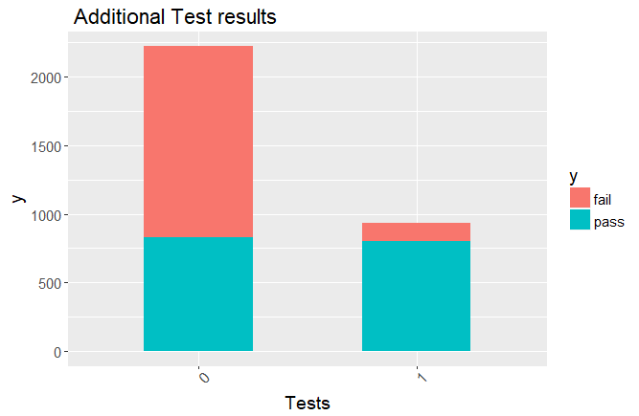
Additional Data Files:

Slide 8
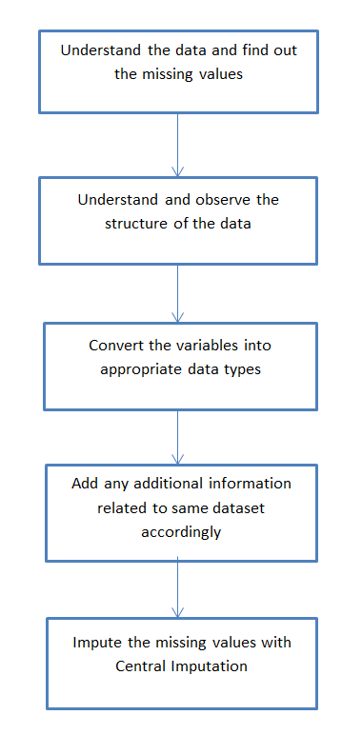
Data Preprocessing

Slide 9
Model Building
Logistic Regression
Logistic Regression with cross validation
Logistic with lasso Regularization
Naïve Bayes & with cross validation
Decision Tree
C50
Cart with cross validation
Random Forest
GBM
XGBoost
MLP

Slide 10
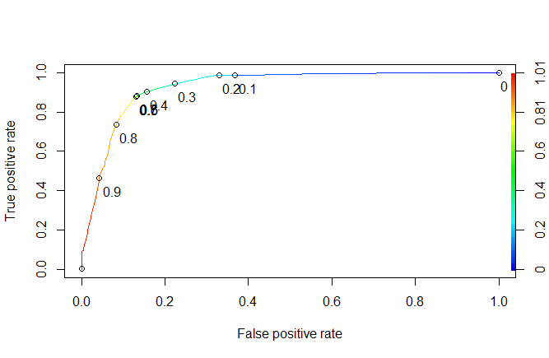
Tuning parameters
Logistic Regression
The model gives us the probabilities of each category so we need to fix the cut off value for that plot roc curve to check cutoff values. Here the Roc curve.
This plot showing the cutoff value as 0.4

Slide 11
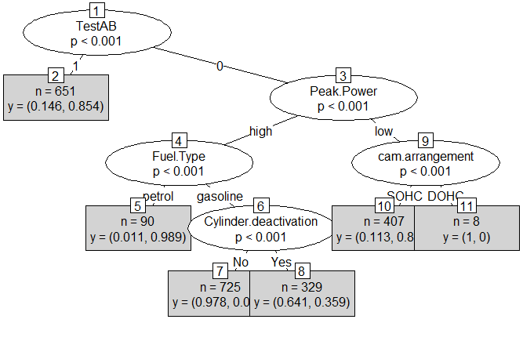
Decision Tree : plot of Decision tree
parameters
mincriterion=0.99
minsplit=200

Slide 12
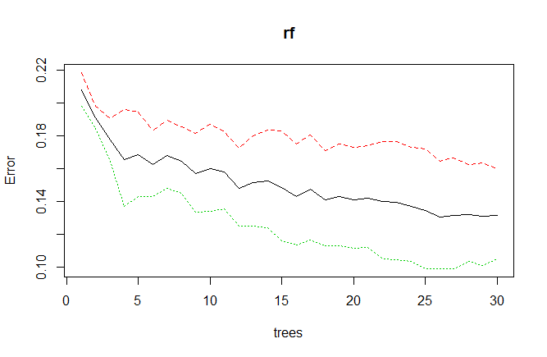
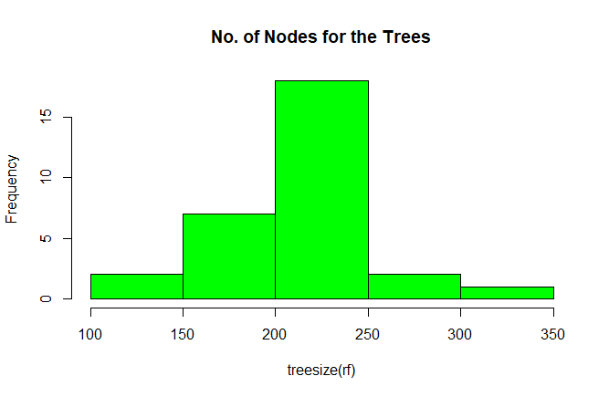
Random Forest:
This plot I choose ntree value is 30
Average no of nodes per each tree is 200 to 250

Slide 13
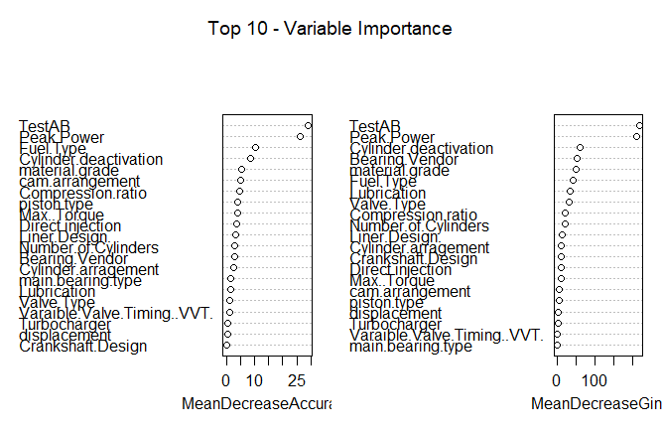
Important features from Random forest :

Slide 14
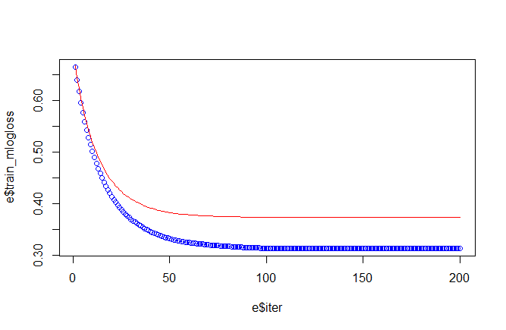
XGBoost : Error plot between Train and validation
After 60 iterations the train and validation errors are constant

Slide 15
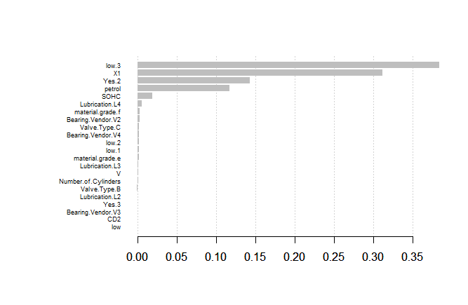
Important variable from XGBoost
eta = 0.05,
max depth = 3,
gamma = 1,
subsample = 1

Slide 16
Predictions
Train |  |  |  |  | validation
Model Name | Accuracy | Sensitivity | Specificity |  | Model Name | Accuracy | Sensitivity | Specificity
Logistic Regression | 87.55 | 90.08 | 84.08 |  | Logistic Regression | 84.08 | 84.09 | 84.8
K-Fold for Logistic | 87.51 | 86.73 | 88.25 |  | K-Fold for Logistic | 84.78 | 84.72 | 84.84
LASSO Regression | 87.6 | 86.73 | 88.42 |  | LASSO Regression | 84.88 | 84.72 | 85.04
Naïve Bayes | 82 | 77 | 87 |  | Naïve Bayes | 85 | 80 | 89
DecisionTree | 87.51 | 88.25 | 86.73 |  | DecisionTree | 84.99 | 85.04 | 84.93
c50 | 87.15 | 87.29 | 87.02 |  | c50 | 84.57 | 84.06 | 85.04
c50 with k-cross | 87.65 | 86.73 | 88.51 |  | c50 with k-cross | 84.88 | 84.93 | 85.04
Random Forest | 90.7 | 87.57 | 93.77 |  | Random Forest | 85.52 | 82.31 | 88.52
GBM | 90.63 | 90.75 | 90.53 |  | GBM | 83.93 | 83.7 | 84.15
SVM(radial) | 93.89 | 92.62 | 95.09 |  | SVM(radial) | 83.09 | 81 | 85
SVM k fold | 87.06 | 85.98 | 88.07 |  | SVM k fold | 84.99 | 84.93 | 85.04
SVM(rbfdot) | 92.26 | 92.21 | 93.25 |  | SVM(rbfdot) | 83.19 | 81.66 | 84.63
XGBoost | 87.06 | 85.98 | 88.07 |  | XGBoost | 84.88 | 84.5 | 85.25
MLP | 89.25 |  |  |  | MLP | 85.07

Slide 17
Conclusion
Comparing with all the models Logistic and Random forest scores are little high .However there was not much of a difference in results between Logistic and ensemble models.
I thought some more information may helpful to get good accuracy.

Slide 18
Thank You

